Slide 1


Session 2
Jdbc
Servlet
Version : v1.0

Slide 2



Agenda
Advance JAVA
JDBC
Servlet
JSP
Servlet
Need
Architecture
Servlet Life Cycle
Internal Working
Questions and Answer's focus on accessing Oracle databases

Slide 3
JDBC – Java DataBase Connectivity
Object Oriented Software Engineering

Slide 4
What is JDBC?
“An API that lets you access virtually any tabular data source from the Java programming language”
JDBC Data Access API – JDBC Technology Homepage
What’s an API?
See J2SE documentation
What’s a tabular data source?
“… access virtually any data source, from relational databases to spreadsheets and flat files.”
JDBC Documentation
We’ll focus on accessing Oracle databases

Slide 5
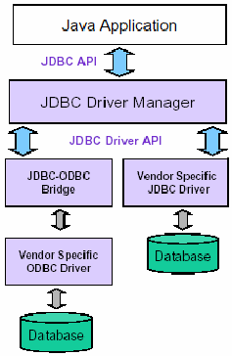
General Architecture
What design pattern is implied in this architecture?
What does it buy for us?
Why is this architecture also multi-tiered?

Slide 6
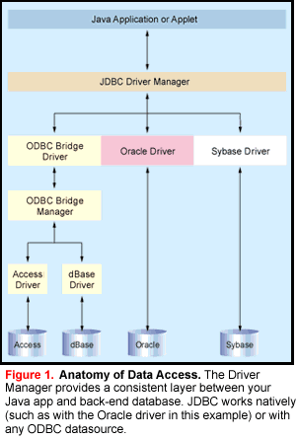

Slide 7
Basic steps to use a database in Java
1.Establish a connection
2.Create JDBC Statements
3.Execute SQL Statements
4.GET ResultSet
5.Close connections

Slide 8
1. Establish a connection
import java.sql.*;
Load the vendor specific driver
Class.forName("oracle.jdbc.driver.OracleDriver");
What do you think this statement does, and how?
Dynamically loads a driver class, for Oracle database
Make the connection
Connection con = DriverManager.getConnection( "jdbc:oracle:thin:@oracle-prod:1521:OPROD", username, passwd);
What do you think this statement does?
Establishes connection to database by obtaining a Connection object

Slide 9
2. Create JDBC statement(s)
Statement stmt = con.createStatement() ;
Creates a Statement object for sending SQL statements to the database

Slide 10
Executing SQL Statements
String createLehigh = "Create table Lehigh " +
"(SSN Integer not null, Name VARCHAR(32), " + "Marks Integer)";
stmt.executeUpdate(createLehigh);
//What does this statement do?
String insertLehigh = "Insert into Lehigh values“ + "(123456789,abc,100)";
stmt.executeUpdate(insertLehigh);

Slide 11
Get ResultSet
String queryLehigh = "select * from Lehigh";
ResultSet rs = Stmt.executeQuery(queryLehigh);
//What does this statement do?
while (rs.next()) {
int ssn = rs.getInt("SSN");
String name = rs.getString("NAME");
int marks = rs.getInt("MARKS");
}

Slide 12
Close connection
stmt.close();
con.close();

Slide 13
Transactions and JDBC
JDBC allows SQL statements to be grouped together into a single transaction
Transaction control is performed by the Connection object, default mode is auto-commit, I.e., each sql statement is treated as a transaction
We can turn off the auto-commit mode with con.setAutoCommit(false);
And turn it back on with con.setAutoCommit(true);
Once auto-commit is off, no SQL statement will be committed until an explicit is invoked con.commit();
At this point all changes done by the SQL statements will be made permanent in the database.

Slide 14
Handling Errors with Exceptions
Programs should recover and leave the database in a consistent state.
If a statement in the try block throws an exception or warning, it can be caught in one of the corresponding catch statements
How might a finally {…} block be helpful here?
E.g., you could rollback your transaction in a catch { …} block or close database connection and free database related resources in finally {…} block

Slide 15
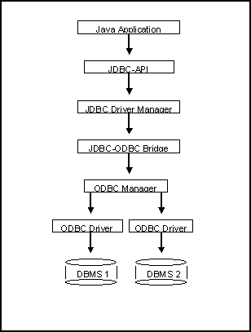
Another way to access database (JDBC-ODBC)
What’s a bit different
about this architecture?
Why add yet
another layer?

Slide 16
Sample program
import java.sql.*;
class Test {
public static void main(String[] args) {
try {
Class.forName("sun.jdbc.odbc.JdbcOdbcDriver"); //dynamic loading of driver
String filename = "c:/db1.mdb"; //Location of an Access database
String database = "jdbc:odbc:Driver={Microsoft Access Driver (*.mdb)};DBQ=";
database+= filename.trim() + ";DriverID=22;READONLY=true}"; //add on to end
Connection con = DriverManager.getConnection( database ,"","");
Statement s = con.createStatement();
s.execute("create table TEST12345 ( firstcolumn integer )");
s.execute("insert into TEST12345 values(1)");
s.execute("select firstcolumn from TEST12345");

Slide 17
Sample program(cont)
ResultSet rs = s.getResultSet();
if (rs != null) // if rs == null, then there is no ResultSet to view
while ( rs.next() ) // this will step through our data row-by-row
{ /* the next line will get the first column in our current row's ResultSet
as a String ( getString( columnNumber) ) and output it to the screen */
System.out.println("Data from column_name: " + rs.getString(1) );
}
s.close(); // close Statement to let the database know we're done with it
con.close(); //close connection
}
catch (Exception err) { System.out.println("ERROR: " + err); }
}
}

Slide 18
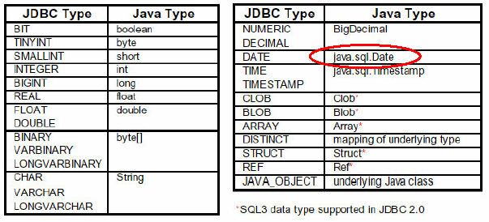
Mapping types JDBC - Java

Slide 19
JDBC 2 – Scrollable Result Set
…
Statement stmt =
con.createStatement(ResultSet.TYPE_SCROLL_INSENSITIVE,
ResultSet.CONCUR_READ_ONLY);
String query = “select students from class where type=‘not sleeping’ “;
ResultSet rs = stmt.executeQuery( query );
rs.previous(); / / go back in the RS (not possible in JDBC 1…)
rs.relative(-5); / / go 5 records back
rs.relative(7); / / go 7 records forward
rs.absolute(100); / / go to 100th record
…

Slide 20
JDBC 2 – Updateable ResultSet
…
Statement stmt =
con.createStatement(ResultSet.TYPE_FORWARD_ONLY,
ResultSet.CONCUR_UPDATABLE);
String query = " select students, grade from class
where type=‘really listening this presentation☺’ “;
ResultSet rs = stmt.executeQuery( query );
…
while ( rs.next() )
{
int grade = rs.getInt(“grade”);
rs.updateInt(“grade”, grade+10);
rs.updateRow();
}

Slide 21
Metadata from DB
A Connection's database is able to provide schema information describing its tables, its supported SQL grammar, its stored procedures the capabilities of this connection, and so on
What is a stored procedure?
Group of SQL statements that form a logical unit and perform a particular task
This information is made available through a DatabaseMetaData object.

Slide 22
Metadata from DB - example
…
Connection con = …. ;
DatabaseMetaData dbmd = con.getMetaData();
String catalog = null;
String schema = null;
String table = “sys%”;
String[ ] types = null;
ResultSet rs =
dbmd.getTables(catalog , schema , table , types );
…

Slide 23
JDBC – Metadata from RS
public static void printRS(ResultSet rs) throws SQLException
{
ResultSetMetaData md = rs.getMetaData();
// get number of columns
int nCols = md.getColumnCount();
// print column names
for(int i=1; i < nCols; ++i)
System.out.print( md.getColumnName( i)+",");
/ / output resultset
while ( rs.next() )
{ for(int i=1; i < nCols; ++i)
System.out.print( rs.getString( i)+",");
System.out.println( rs.getString(nCols) );
}
}

Slide 24
JDBC and beyond
(JNDI) Java Naming and Directory Interface
API for network-wide sharing of information about users, machines, networks, services, and applications
Preserves Java’s object model
(JDO) Java Data Object
Models persistence of objects, using RDBMS as repository
Save, load objects from RDBMS
(SQLJ) Embedded SQL in Java
Standardized and optimized by Sybase, Oracle and IBM
Java extended with directives: # sql
SQL routines can invoke Java methods
Maps SQL types to Java classes

Slide 25
SQLJ
// SQLJ
int n;
#sql { INSERT INTO emp VALUES (:n)};
// vs. straight JDBC
int n;
Statement stmt = conn.prepareStatement
(“INSERT INTO emp VALUES (?)”);
stmt.setInt(1,n);
stmt.execute ();
stmt.close();

Slide 26
JDBC references
JDBC Data Access API – JDBC Technology Homepage
http://java.sun.com/products/jdbc/index.html
JDBC Database Access – The Java Tutorial
http://java.sun.com/docs/books/tutorial/jdbc/index.html
JDBC Documentation
http://java.sun.com/j2se/1.4.2/docs/guide/jdbc/index.html
java.sql package
http://java.sun.com/j2se/1.4.2/docs/api/java/sql/package-summary.html
JDBC Technology Guide: Getting Started
http://java.sun.com/j2se/1.4.2/docs/guide/jdbc/getstart/GettingStartedTOC.fm.html
JDBC API Tutorial and Reference (book)
http://java.sun.com/docs/books/jdbc/

Slide 27
JDBC
JDBC Data Access API – JDBC Technology Homepage
http://java.sun.com/products/jdbc/index.html
JDBC Database Access – The Java Tutorial
http://java.sun.com/docs/books/tutorial/jdbc/index.html
JDBC Documentation
http://java.sun.com/j2se/1.4.2/docs/guide/jdbc/index.html
java.sql package
http://java.sun.com/j2se/1.4.2/docs/api/java/sql/package-summary.html
JDBC Technology Guide: Getting Started
http://java.sun.com/j2se/1.4.2/docs/guide/jdbc/getstart/GettingStartedTOC.fm.html
JDBC API Tutorial and Reference (book)
http://java.sun.com/docs/books/jdbc/

Slide 28
DatabaseMetaData
Data about data is known as metadata. The DatabaseMetaData interface provides methods to get information about the database you have connected with like, database name, database driver version, maximum column length etc.

Slide 29
Databasemeta Example
public static void main(String args[])throws Exception {
//Getting the connection
String mysqlUrl = "jdbc:mysql://localhost/sampleDB";
Connection con = DriverManager.getConnection(mysqlUrl, "root", "password");
System.out.println("Connection established......");
//Creating the DatabaseMetaData object
DatabaseMetaData dbMetadata = con.getMetaData();
//invoke the supportsBatchUpdates() method.
boolean bool = dbMetadata.supportsBatchUpdates();
if(bool) {
System.out.println("Underlying database supports batch updates");
} else {
System.out.println("Underlying database doesnt supports batch updates");
}
//Retrieving the driver name
System.out.println(dbMetadata.getDriverName());
//Retrieving the driver version
System.out.println(dbMetadata.getDriverVersion());
//Retrieving the user name
System.out.println(dbMetadata.getUserName());
//Retrieving the URL
System.out.println(dbMetadata.getURL());
//Retrieving the list of numeric functions
System.out.println("Numeric functions: "+dbMetadata.getNumericFunctions());
System.out.println("");
//Retrieving the list of String functions
System.out.println("String functions: "+dbMetadata.getStringFunctions());
System.out.println("");
//Retrieving the list of system functions
System.out.println("System functions: "+dbMetadata.getSystemFunctions());
System.out.println("");
//Retrieving the list of time and date functions
System.out.println("Time and Date funtions: "+dbMetadata.getTimeDateFunctions());
}

Slide 30
Database
Method | Description
getDriverName() | Retrieves the name of the current JDBC driver
getDriverVersion() | Retrieves the version of the current JDBC driver
getUserName() | Retrieves the user name.
getDatabaseProductName() | Retrieves the name of the current database.
getDatabaseProductVersion() | Retrieves the version of the current database.
getNumericFunctions() | Retrieves the list of the numeric functions available with this database.
getStringFunctions() | Retrieves the list of the numeric functions available with this database.
getSystemFunctions() | Retrieves the list of the system functions available with this database.
getTimeDateFunctions() | Retrieves the list of the time and date functions available with this database.
getURL() | Retrieves the URL for the current database.
supportsSavepoints() | Verifies weather the current database supports save points
supportsStoredProcedures() | Verifies weather the current database supports stored procedures.
supportsTransactions() | Verifies weather the current database supports transactions.

Slide 31
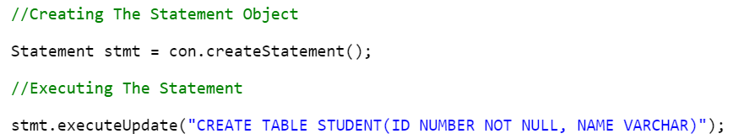
Statement
Statement interface is used to execute normal SQL queries. You can’t pass the parameters to SQL query at run time using this interface. This interface is preferred over other two interfaces if you are executing a particular SQL query only once.
The performance of this interface is also very less compared to other two interfaces. In most of time, Statement interface is used for DDL statements like CREATE, ALTER, DROP,SELECT etc. For example,

Slide 32
Statement | PreparedStatement | CallableStatement
It is used to execute normal SQL queries. | It is used to execute parameterized or dynamic SQL queries. | It is used to call the stored procedures.
It is preferred when a particular SQL query is to be executed only once. | It is preferred when a particular query is to be executed multiple times. | It is preferred when the stored procedures are to be executed.
You cannot pass the parameters to SQL query using this interface. | You can pass the parameters to SQL query at run time using this interface. | You can pass 3 types of parameters using this interface. They are – IN, OUT and IN OUT.
This interface is mainly used for DDL statements like CREATE, ALTER, DROP etc. | It is used for any kind of SQL queries which are to be executed multiple times. | It is used to execute stored procedures and functions.
The performance of this interface is very low. | The performance of this interface is better than the Statement interface (when used for multiple execution of same query). | The performance of this interface is high.

Slide 33
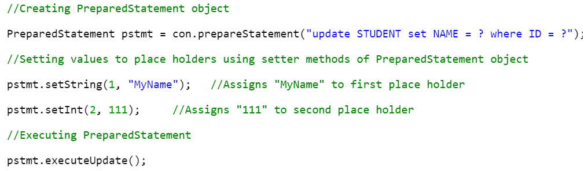
PreparedStatement
PreparedStatement is used to execute dynamic or parameterized SQL queries. PreparedStatement extends Statement interface. You can pass the parameters to SQL query at run time using this interface. It is recommended to use PreparedStatement if you are executing a particular SQL query multiple times.
It gives better performance than Statement interface. Because, PreparedStatement are precompiled and the query plan is created only once irrespective of how many times you are executing that query. This will save lots of time.

Slide 34
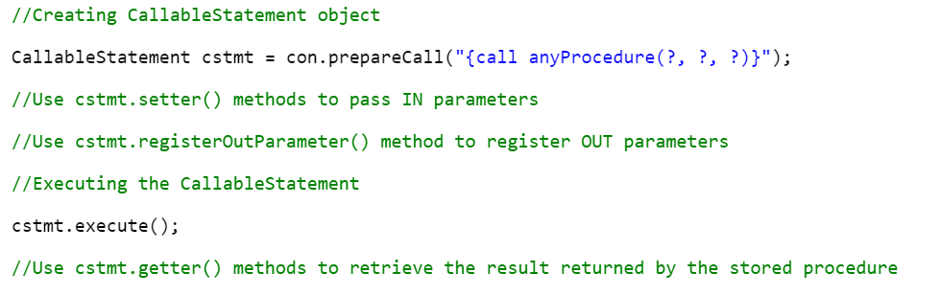
CallableStatement
CallableStatement is used to execute the stored procedures. CallableStatement extends PreparedStatement. Usng CallableStatement, you can pass 3 types of parameters to stored procedures. They are : IN – used to pass the values to stored procedure, OUT – used to hold the result returned by the stored procedure and IN OUT – acts as both IN and OUT parameter. Before calling the stored procedure, you must register OUT parameters using registerOutParameter() method of CallableStatement. The performance of this interface is higher than the other two interfaces. Because, it calls the stored procedures which are already compiled and stored in the database server.

Slide 35
Servlet
Servlet is a java program that runs inside JVM on the web server.
It is used for developing dynamic web applications.

Slide 36
Life Cycle of Servlet
Servlet life cycle contains five steps:
Loading of Servlet
Creating instance of Servlet
Invoke init() once
Invoke service() repeatedly for each client request
Invoke destroy()

Slide 37
Step 1: Loading of Servlet
When the web server (e.g. Apache Tomcat) starts up, the servlet container deploy and loads all the servlets.
Step 2: Creating instance of Servlet
Once all the Servlet classes loaded, the servlet container creates instances of each servlet class. Servlet container creates only once instance per servlet class and all the requests to the servlet are executed on the same servlet instance.
Step 3: Invoke init() method
Once all the servlet classes are instantiated, the init() method is invoked for each instantiated servlet.

Slide 38
Step 4: Invoke service() method
Each time the web server receives a request for servlet, it spawns a new thread that calls service() method.
If the servlet is GenericServlet then the request is served by the service() method itself,
if the servlet is HttpServlet then service() method receives the request and dispatches it to the correct handler method based on the type of request.
Step 5: Invoke destroy() method
When servlet container shuts down(this usually happens when we stop the web server), it unloads all the servlets and calls destroy() method for each initialized servlets.

Slide 39
Architecture Diagram:
The following figure depicts a typical servlet life-cycle scenario.
First the HTTP requests coming to the server are delegated to the servlet container.
The servlet container loads the servlet before invoking the service() method.
Then the servlet container handles multiple requests by spawning multiple threads, each thread executing the service() method of a single instance of the servlet.

Slide 40
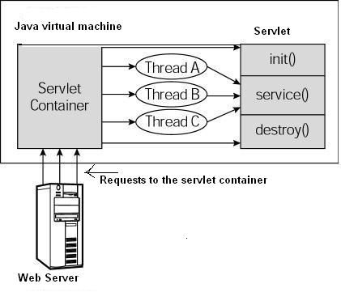
Architecture Diagram:

Slide 41
JVM
Container
Servlet A
Init()
Container invoke the init() method, to initialize the servlet.
Servlet B
Init()

Slide 42
JVM
Container
Thread 1A
HttpRequest , HttpResponse
1st Request
Servlet A
2nd Request
Thread 2A
HttpRequest , HttpResponse
3rd Request
Thread 3A
HttpRequest , HttpResponse
Servlet B
Thread 1B
HttpRequest , HttpResponse
1st Request
2nd Request
Thread 2B
HttpRequest , HttpResponse
3rd Request
Thread 3B
HttpRequest , HttpResponse

Slide 43
JVM
Container
Container invoke the service() method, to handle the request.
Thread 1A
HttpRequest , HttpResponse
Servlet A
Service()
Thread 2A
HttpRequest , HttpResponse
Thread 3A
HttpRequest , HttpResponse
Thread 1B
HttpRequest , HttpResponse
Servlet B
Service()
Thread 2B
HttpRequest , HttpResponse
Thread 3B
HttpRequest , HttpResponse

Slide 44
JVM
Container
Container invoke the destroy() method, to destroy the servlet.
Ready for Garbage collection
Servlet A
destroy()
Servlet B
destroy()

Slide 45
How Servlet Works?
When the web server (e.g. Apache Tomcat) starts up, the servlet container deploy and loads all the servlets.
Once the servlet is loaded, the servlet container creates the instance of servlet class. For each instantiated servlet, its init() method is invoked.
Client (user browser) sends an Http request to web server on a certain port. Each time the web server receives a request, the servlet container creates HttpServletRequest and HttpServletResponse objects. The HttpServletRequest object provides the access to the request information and the HttpServletResponse object allows us to format and change the http response before sending it to the client.
When servlet container shuts down, it unloads all the servlets and calls destroy() method for each initialized servlets.

Slide 46
import javax.servlet.http.*;
import javax.servlet.*;
import java.io.*;
public class DemoServlet extends HttpServlet{
public void doGet(HttpServletRequest req,HttpServletResponse res)
throws ServletException,IOException
{
res.setContentType("text/html");//setting the content type
PrintWriter pw=res.getWriter();//get the stream to write the data
//writing html in the stream
pw.println("<html><body>");
pw.println("Welcome to servlet");
pw.println("</body></html>");
pw.close();//closing the stream
}
}

Slide 47
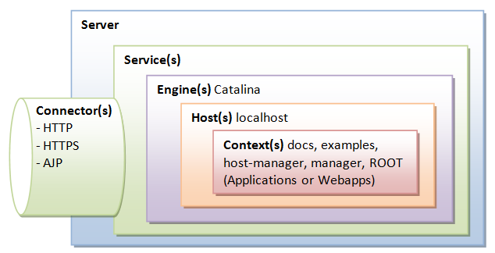
Insights of Web Server
Notes:
kkkk

Slide 48
Thank you

